Slide 1
Understanding Language

Slide 2
Recurrent Neural Network

Slide 3
Recurrent Neural Network
y1
y2
y3
y4
yn
a0
a1
a2
a3
….
a4
an
x1
….
xn
x2
x3
x4

Slide 4
Recurrent Neural Network
y1
y2
y3
y4
yn
a0
a1
a2
a3
….
a4
a14
x1
….
xn
x2
x3
x4

Slide 5
Recurrent Neural Network
y1
y2
y3
y4
yn
a0
a1
a2
a3
….
a4
a14
x1
….
xn
x2
x3
x4

Slide 6
Recurrent Neural Network
y1
y2
y3
y4
yn
a0
a1
a2
a3
….
a4
a14
x1
….
xn
x2
x3
x4

Slide 7
Recurrent Neural Network
y1
y2
y3
y4
yn
a0
a1
a2
a3
….
a4
a14
x1
….
xn
x2
x3
x4

Slide 8
Recurrent Neural Network
y1
y2
y3
y4
yn
a0
a1
a2
a3
….
a4
a14
x1
….
xn
x2
x3
x4

Slide 9
Recurrent Neural Network
y1
y2
y3
y4
yn
a0
a1
a2
a3
….
a4
a14
x1
….
xn
x2
x3
x4

Slide 10
Recurrent Neural Network
y1
y2
y3
y4
yn
a0
a1
a2
a3
….
a4
a14
x1
….
xn
x2
x3
x4

Slide 11
Recurrent Neural Network
y1
y2
y3
y4
yn
a0
a1
a2
a3
….
a4
a14
x1
….
xn
x2
x3
x4

Slide 12
Recurrent Neural Network
y1
y2
y3
y4
yn
a0
a1
a2
a3
….
a4
a14
x1
….
xn
x2
x3
x4

Slide 13
Recurrent Neural Network
y1
y2
y3
y4
yn
a0
a1
a2
a3
….
a4
a14
x1
….
xn
x2
x3
x4

Slide 14
Recurrent Neural Network
y1
y2
y3
y4
yn
a0
a1
a2
a3
….
a4
a14
x1
….
xn
x2
x3
x4

Slide 15
Recurrent Neural Network
y1
y2
y3
y4
yn
a0
a1
a2
a3
….
a4
a14
x1
….
xn
x2
x3
x4

Slide 16
Recurrent Neural Network
y1
y2
y3
y4
yn
a0
a1
a2
a3
….
a4
a14
x1
….
xn
x2
x3
x4

Slide 17
Recurrent Neural Network
y1
y2
y3
y4
yn
a0
a1
a2
a3
….
a4
a14
x1
….
xn
x2
x3
x4

Slide 18
Recurrent Neural Network
y1
y2
y3
y4
yn
a0
a1
a2
a3
….
a4
a14
x1
….
xn
x2
x3
x4

Slide 19
Natural Language Processing

Slide 20
Natural Language Processing

Slide 21
Natural Language Processing

Slide 22
NLP

Slide 23
AI
NLP
Linguistics

Slide 24
Challenges doing NLP

Slide 25
Ambiguity in Language

Slide 26
That is your computer.

Slide 27
That is your computer.
That isn’t your computer.

Slide 28
That is your computer.
That isn’t your computer.

Slide 29
That is your computer.
That isn’t your computer.
Is that your computer?

Slide 30
That is your computer.
That isn’t your computer.
Is that your computer?
Isn’t that your computer?

Slide 31
That is your computer.
That isn’t your computer.
Is that your computer?
Isn’t that your computer?

Slide 32
Misheard Speech
“Recognize speech” or “Wreck a nice beach”

Slide 33
Ambiguous Pronunciation
project (noun) vs. project (verb)

Slide 34
Syntactic Ambiguity
We were out and I saw you last weekend with my wife.

Slide 35
Syntactic Ambiguity
My wife and I were out last weekend and we saw you.

Slide 36
Context

Slide 37
May I have your _________?

Slide 38
May I have your attention?

Slide 39
May I have your number?

Slide 40
May I have your keys?

Slide 41
How do we encode words?

Slide 42
Sentiment Classification
“A touching movie full of emotions with wonderful acting. Worth seeing a second time!”

Slide 43
Preprocess
A touching movie full of emotions with wonderful acting Worth seeing a second time

Slide 44
Lowercase
a touching movie full of emotions with wonderful acting worth seeing a second time

Slide 45
Tokenization
a touching movie full of emotions with wonderful acting worth seeing a second time
[‘a’, ‘touching’, ‘movie’, ‘full’, ‘of’, ‘emotions’, ‘with’, ‘wonderful’, ‘acting’, ‘worth’, ‘seeing’, ‘a’, ‘second’, ‘time’]

Slide 46
Stop words removal
a touching movie full of emotions with wonderful acting worth seeing a second time
[‘touching’, ‘movie’, ‘full’, ‘emotions’, ‘wonderful’, ‘acting’, ‘worth’, ‘seeing’, ‘second’, ‘time’]

Slide 47
Lemmatization
a touching movie full of emotions with wonderful acting worth seeing a second time
[‘touch’, ‘movie’, ‘full’, ‘emotion’, ‘wonder’, ‘act’, ‘worth’, ‘see’, ‘second’, ‘time’]

Slide 48
Text data vectorization
S1: Life wouldn’t be the same without enjoyable music.
S2: The same music everyday wouldn’t be as enjoyable.

Slide 49
Bag of words
S1: Life wouldn’t be the same without enjoyable music.
S2: The same music everyday wouldn’t be as enjoyable.
 | life | wouldn’t | same | without | enjoy | music | everyday
S1 | 1 | 1 | 1 | 1 | 1 | 1
S2 |  | 1 | 1 |  | 1 | 1 | 1

Slide 50
Term Frequency – Inverse Document Frequency
 | life | wouldn’t | same | without | enjoy | music | everyday
S1 | .3 | 0 | 0 | .3 | 0 | 0
S2 |  | 0 | 0 |  | 0 | 0 | .3

Slide 51
Term Frequency – Inverse Document Frequency
 | life | wouldn’t | same | without | enjoy | music | everyday | … | label
S1 | .3 | 0 | 0 | .3 | 0 | 0 |  |  | 1
S2 |  | 0 | 0 |  | 0 | 0 | .3 |  | 0
S3
S4
S5
S6

Slide 52
Word Embeddings

Slide 53
 | Gender | Age | Audible | Edible | Color | …
Woman
Man
Music
Voice
Apple
Orange

Slide 54
 | Gender | Age | Audible | Edible | Color | …
Woman | -1
Man | 1
Music | .02
Voice | .73
Apple | .04
Orange | .03

Slide 55
 | Gender | Age | Audible | Edible | Color | …
Woman | -1 | .37
Man | 1 | .38
Music | .02 | .04
Voice | .73 | .03
Apple | .04 | -.01
Orange | .03 | .00

Slide 56
 | Gender | Age | Audible | Edible | Color | …
Woman | -1 | .37 | .05
Man | 1 | .38 | .07
Music | .02 | .04 | .99
Voice | .73 | .03 | .98
Apple | .04 | -.01 | .06
Orange | .03 | .00 | .03

Slide 57
 | Gender | Age | Audible | Edible | Color | …
Woman | -1 | .37 | .05 | .01
Man | 1 | .38 | .07 | .03
Music | .02 | .04 | .99 | .00
Voice | .73 | .03 | .98 | -.01
Apple | .04 | -.01 | .06 | .97
Orange | .03 | .00 | .03 | .94

Slide 58
 | Gender | Age | Audible | Edible | Color | …
Woman | -1 | .37 | .05 | .01 | .73
Man | 1 | .38 | .07 | .03 | .71
Music | .02 | .04 | .99 | .00 | .03
Voice | .73 | .03 | .98 | -.01 | .02
Apple | .04 | -.01 | .06 | .97 | .88
Orange | .03 | .00 | .03 | .94 | .92

Slide 59
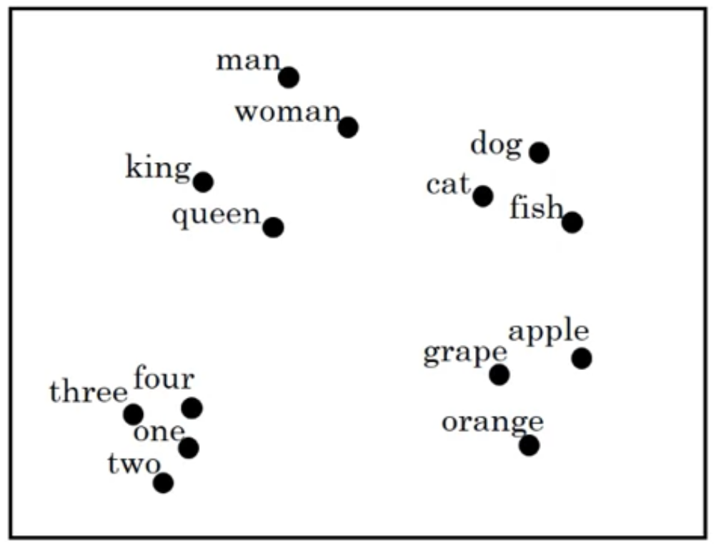

Slide 66
Sentiment Classification
“A touching movie full of emotions with wonderful acting and worth seeing a second time!”

Slide 67
a0
a1
a2
a3
….
a4
a15
A touching movie full …. time

Slide 68
y
a0
a1
a2
a3
….
a4
a15
A touching movie full …. time

